Slide 1
Motivation and School Structure
Dr. Umberto Michelucci
umberto.michelucci@toelt.ai

Slide 2
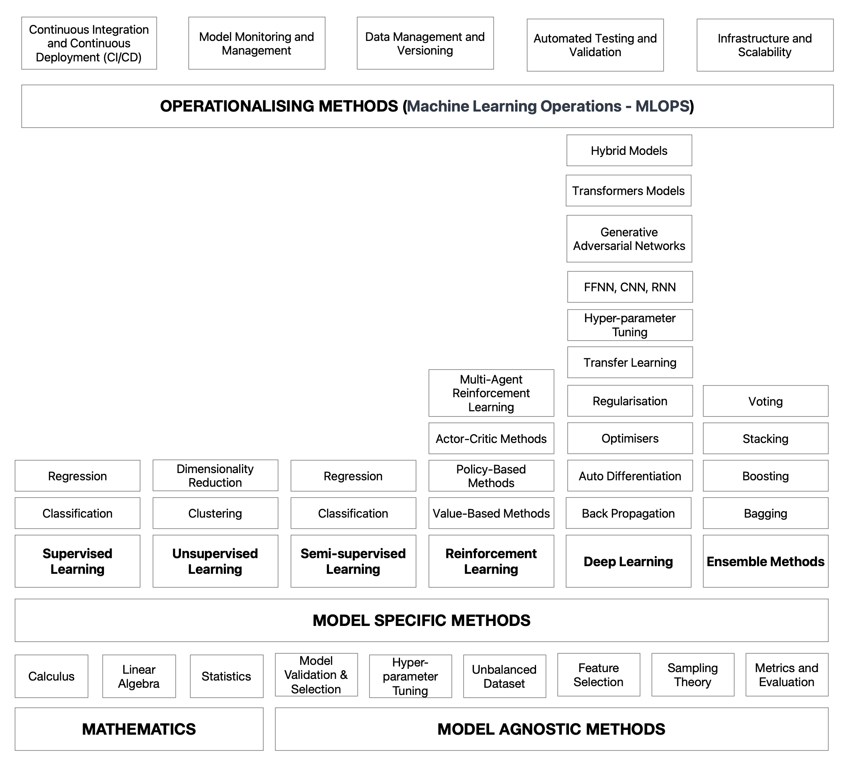
Machine Learning Concepts Taxonomy

Slide 3
Machine Learning Concepts Taxonomy What we will cover

